Slide 1

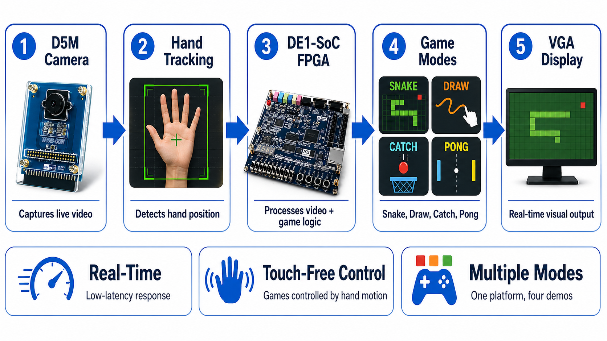
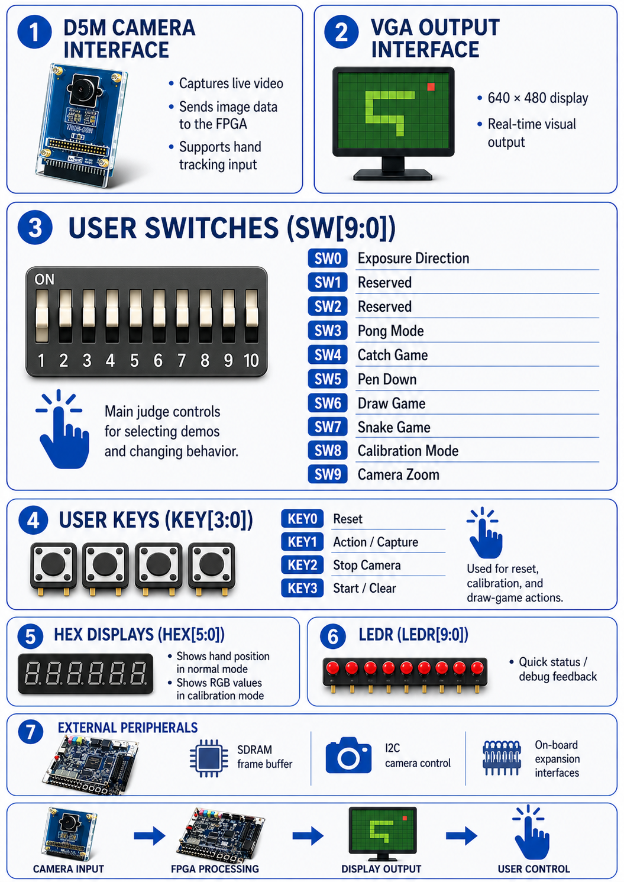
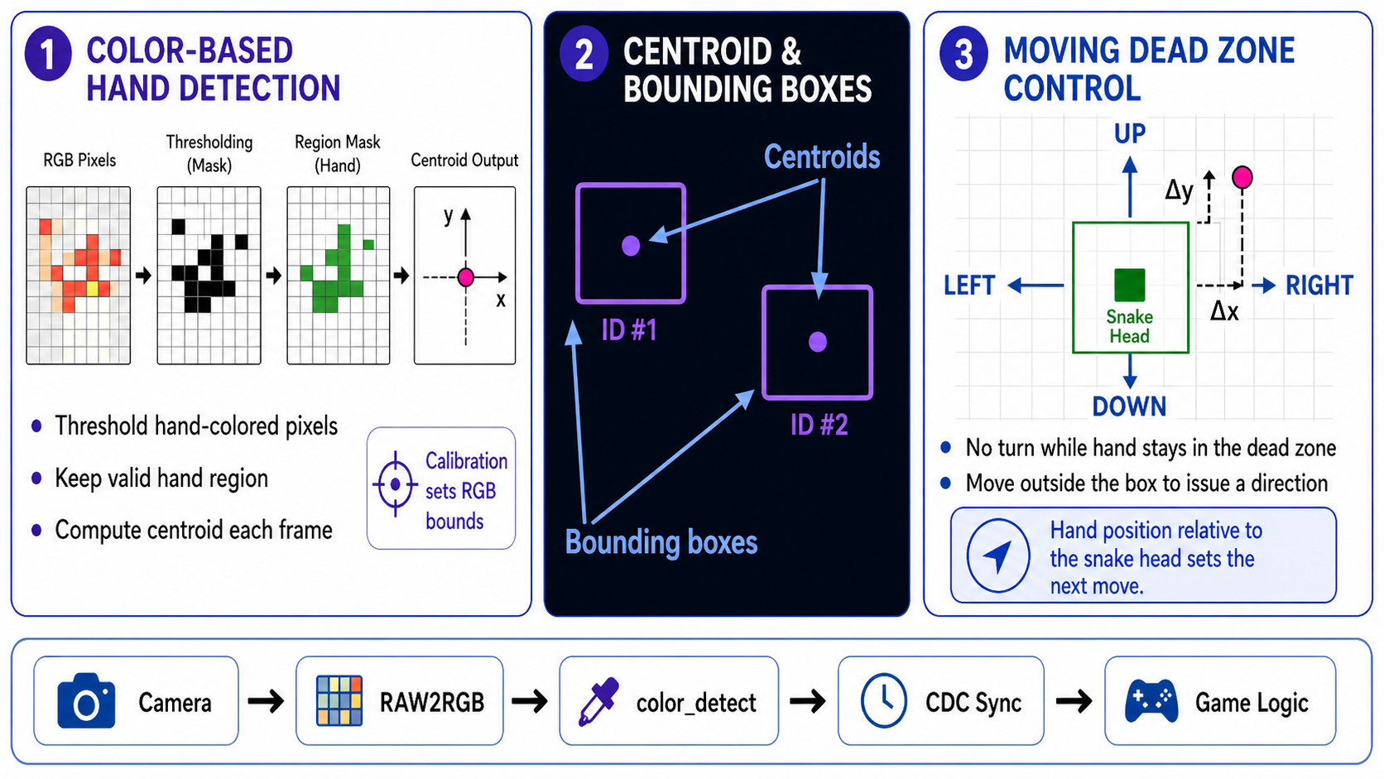
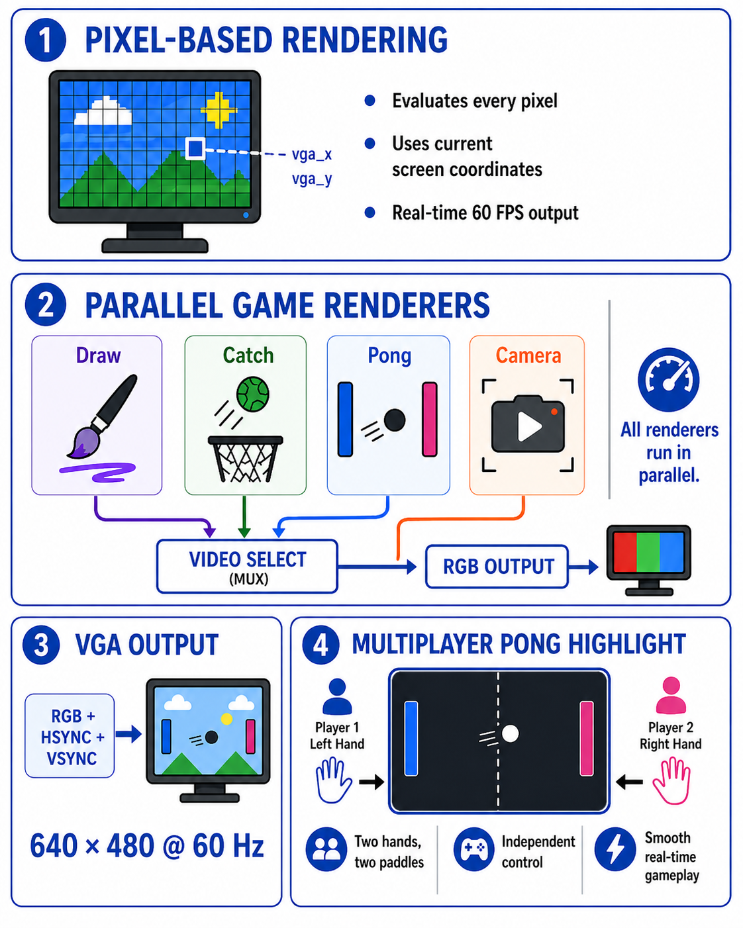
ECE554
Hand-Tracked Interactive Game System
Anirudh Kompella
Chance Howarth
Amer Salem
Munasib Ilham
System Overview
Hardware Interfaces & Peripherals
Core Algorithms
Rendering Pipeline & Game Output
Challenges Future Considerations
Clock Domain Crossing (Camera → VGA): Safe synchronization was required to transfer hand tracking data between different clock domains without instability.
Latency vs. Responsiveness Tradeoff: Frame-based centroid updates improved stability but introduced slight delay in control response.
Designing an Intuitive Control Scheme: A moving dead zone around the snake head was needed to reduce jitter and enable natural gameplay.
AI/ML-Based Hand Tracking: Replacing RGB thresholding with ML techniques could improve robustness to lighting changes and enable gesture recognition.
Enhanced Hardware Platform: Upgrading to a more powerful FPGA or camera would allow for better performance and graphics
Expanded Gameplay: Adding more advanced game mechanics, scoring systems, AI opponents, and modes would enhance overall user experience.
Spring 2026

